Slide 1

IMDb Web Scraping and Data Analysis
Presented By:-
Shehzada Alam
Sameer Pophali
Shreyas Wankhede
Sagar Bhutada
Shehnaaz Shareen

Slide 2
Agenda
Problem Statement
Proposed Solution
Solution Details
Model Building
Challenges
Data Analysis & Visualization.
Conclusion

Slide 3
Problem Statement
The Internet Movie Database (IMDb) is one of the world’s most popular sources for movie, TV and celebrity content with more than 100 million unique visitors per month.
IMDb has huge collection of movies database that includes various details of movies along with different ratings and user reviews.
This movie reviews affects everyone from audience, film critics to the production company.
Idea of our project is to scarp the data from IMDb and form an analysis that will help data analyst or production company to decide how they are going to proceed with making a new movie, second is to form a model to predict what are the sentiments of movies based on user reviews.
Dataset: 3500+ records and has 10 columns.

Slide 4
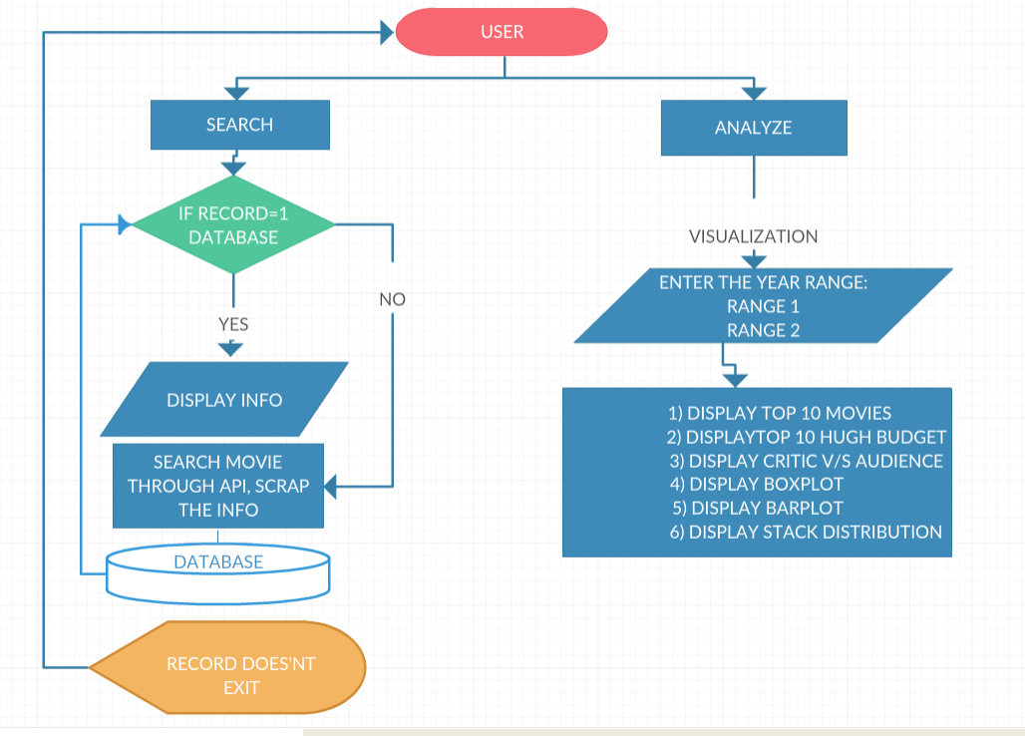
Proposed System:

Slide 5
Solution Details:
Extracting all the details of movies like IMDBID,Title,Genre, Year, Audience rating, Critics rating, Budget and Reviews using 'OMDB API' and webscrapping.
Established the Database Connection as we are storing this movie data in MySQL.
While searching the movie detail if the entry is not present then fetch the detail from imdb through webscraping and with API, insert the record in database and display result back to the user.
For analysis extract the data from database into dataframe and visualize the data to get some insights.

Slide 6
“Sentiment analysis is an important research area that identifies the people’s sentiments, opinions and emotions underlying a text.”
Sentiment Analysis based on User Reviews and created a new column(polarity) which includes this Labels (Positive and Negative).
We have used “Unsupervised lexicon based method”, which are dictionaries or vocabularies of polar words specially constructed for sentiment classification task.
The system uses VADER (Valence Aware Dictionary and sEntiment Reasoner) based lexicon method for sentiment analysis that not only tells about the positive,negative, neutral and compound score between -1 to +1 but gives positive or negative sentiment of reviews based on this score.
To extract this sentiments we have computed the polarity of the given reviews (whether the text is positive or negative).

Slide 7
Model Building
In order to make sense to our machine learning algorithm we have converted each review to a numeric representation which is called 'Vectorization'.
The system uses TF-IDF Vectorizer (Term Frequency-Inverse document frequency) that transforms a count matrix to a normalized frequency representation in float.
Splitting the movie data into Train and Test set (80-20 ratio).
SVM: The objective of a Linear SVC (Support Vector Classifier) is to fit the data, returning a best fit hyperplane that divides or classifies the data.
Accuracy= 79.61%
 | Precision | Recall | f1-score | support
Negative | 0.77 | 0.82 | 0.79 | 371
Positive | 0.83 | 0.77 | 0.80 | 404
Total | 0.80 | 0.80 | 0.80 | 775

Slide 8
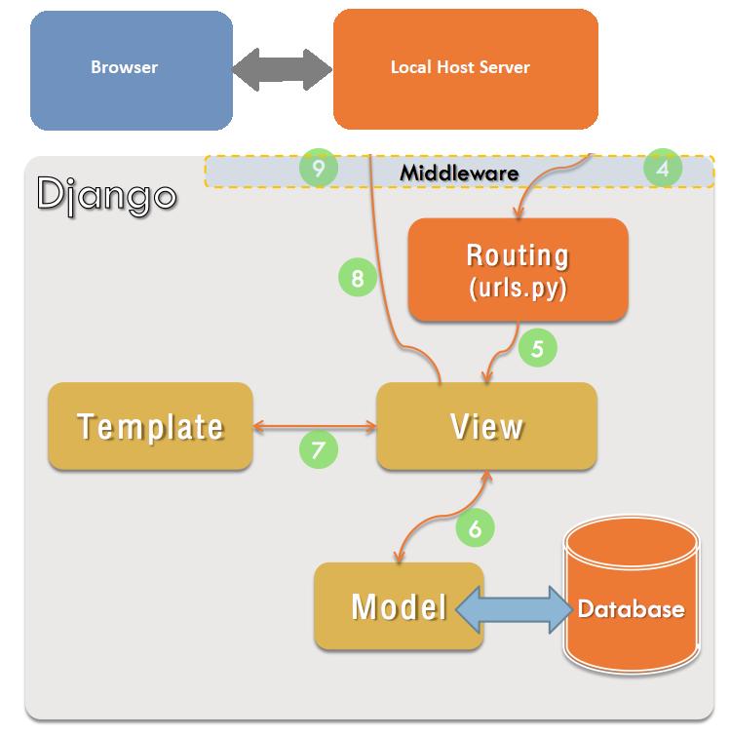
Django Framework
Data Base: MySql
Model: Database model in Django framework
View: Functions to create view
Urls.py: routing urls for every page
Template: html pages of front end

Slide 9
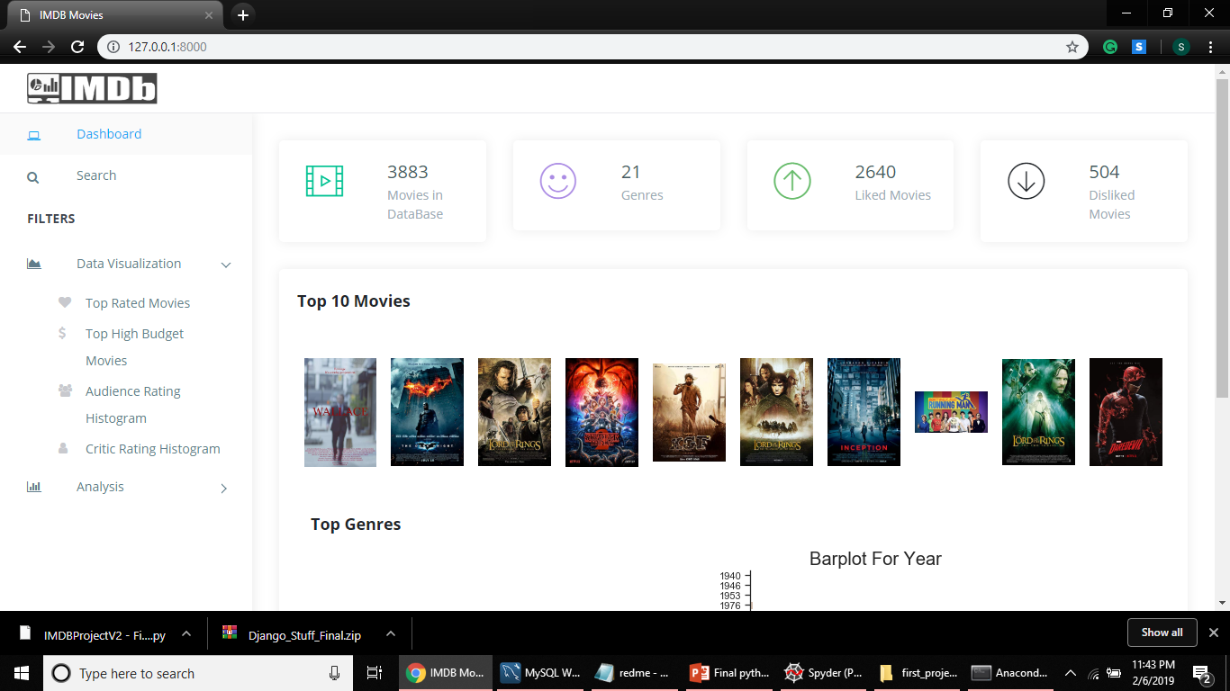
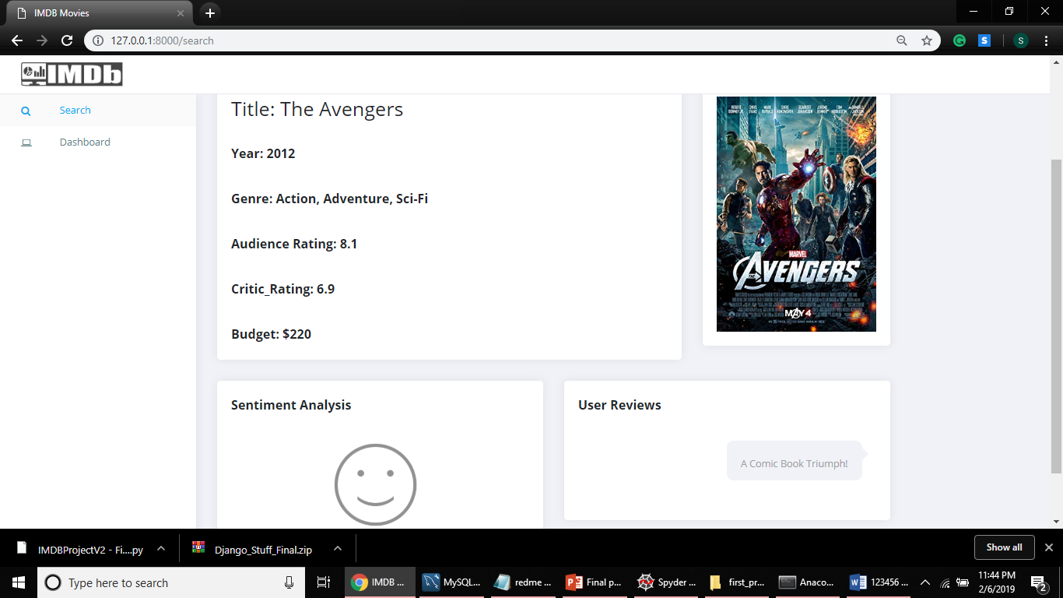
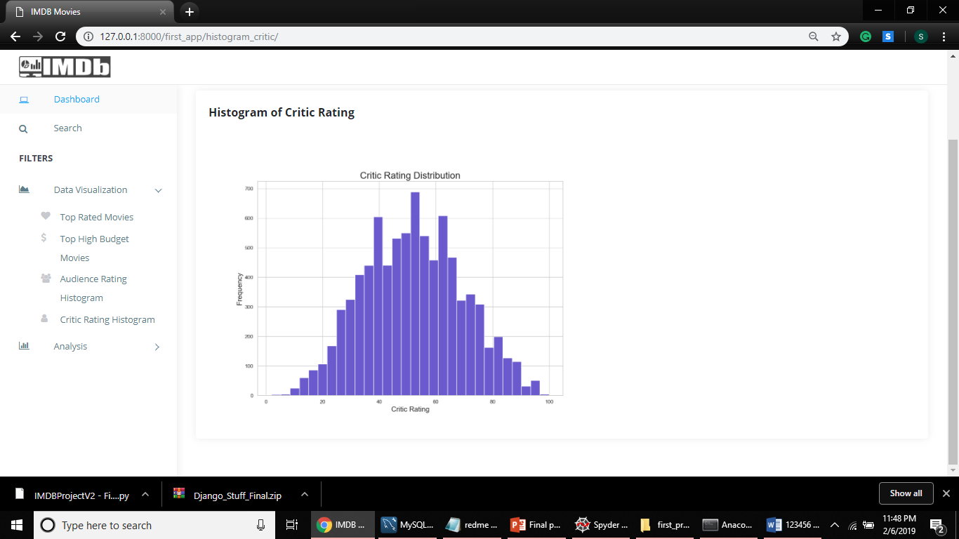
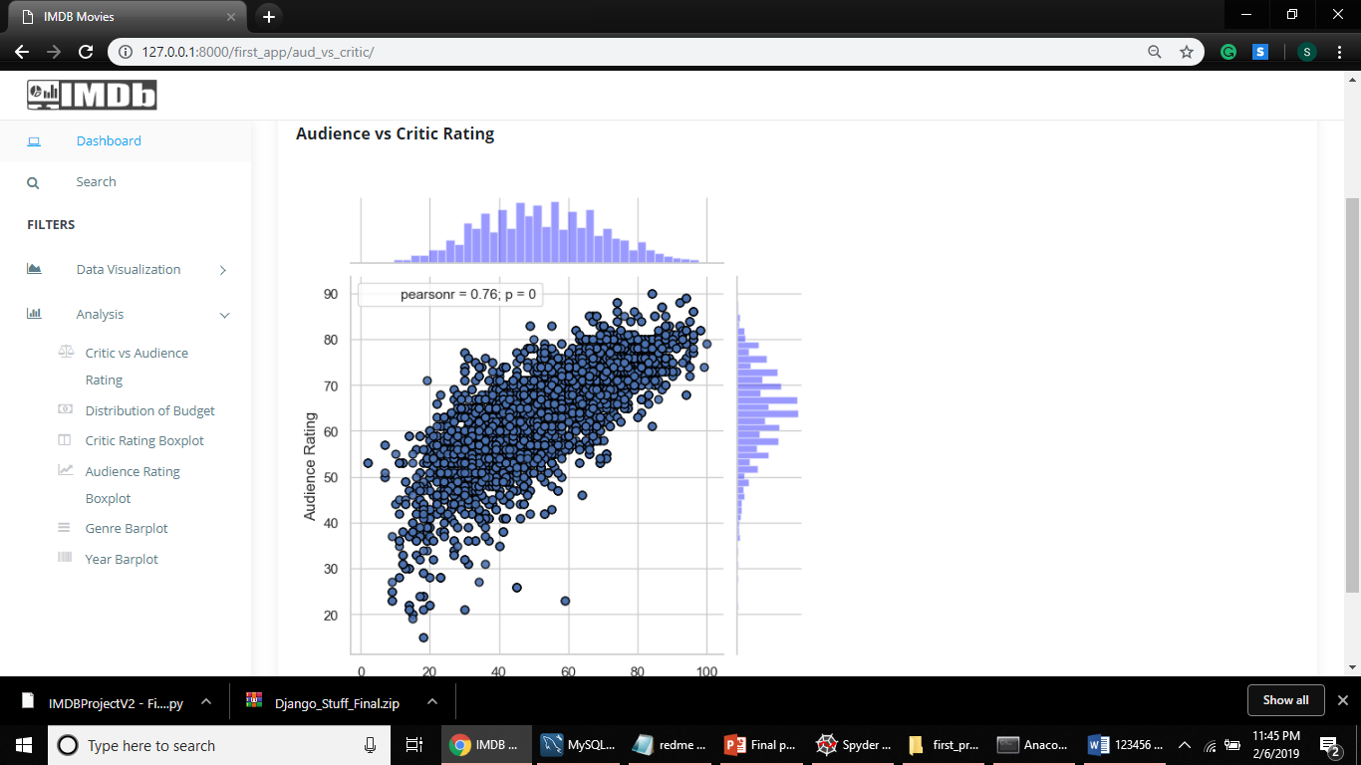
Frontend

Slide 10
Challenges
Using omdb API we were not able to fetch Budget and User Reviews hence we have scrapped the data from imdb website using imdb id.
While fetching 'Budget' from imdb website the amount were present in different currency format so we have converted the currencies in USD by using CurrencyConverter package.
After getting polarity for all the user reviews, this reviews was needed to be converted in numerical representation to fit the classification model.
While rendering seaborn graphs on Django Framework we were getting several response errors and were not able to display the plots.

Slide 11
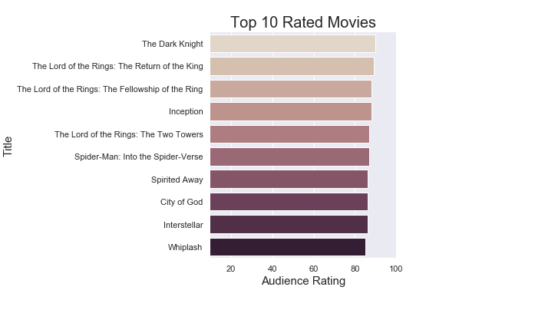
Data Analysis and Visualization: 1) Top 10 Rated Movies:

Slide 12
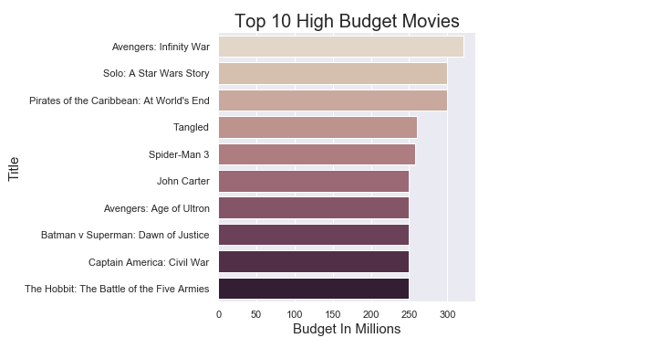
2) Top 10 High Budget Movies:

Slide 13
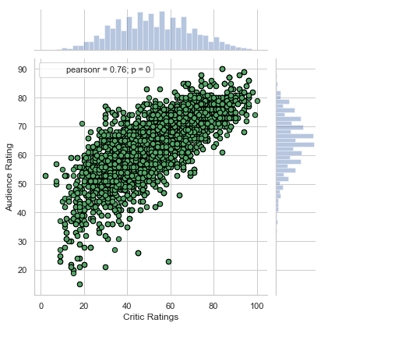
Critic Vs Audience Rating:

Slide 14
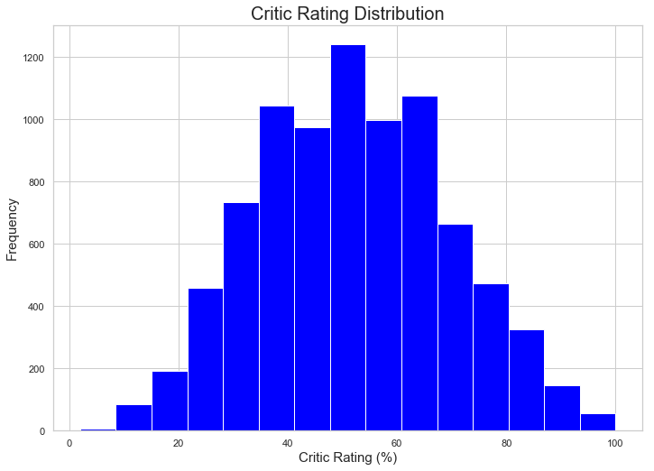
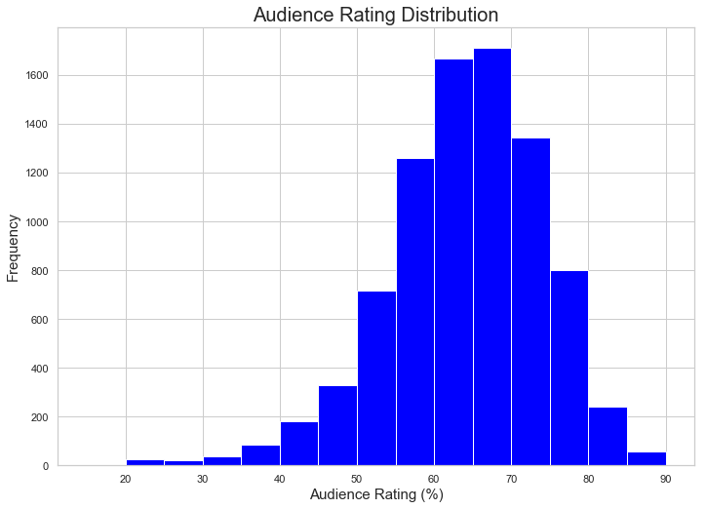
Distribution of Critic or Audience Rating: Critic Rating Audience Rating

Slide 15
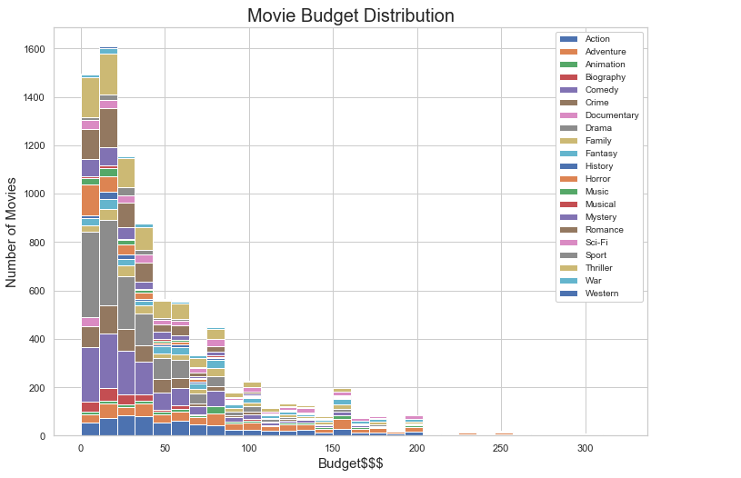
Stack Distribution of Movie Budget:

Slide 16
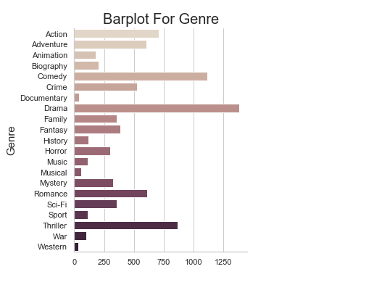
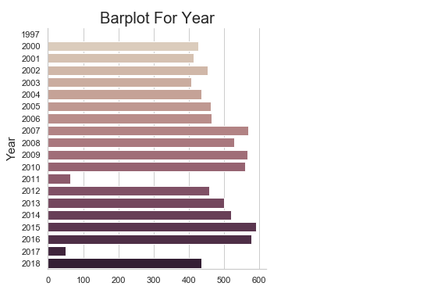
BARPLOT:

Slide 17
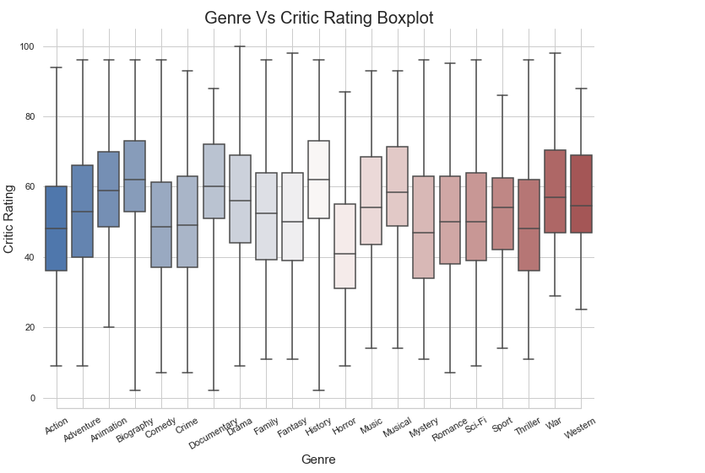
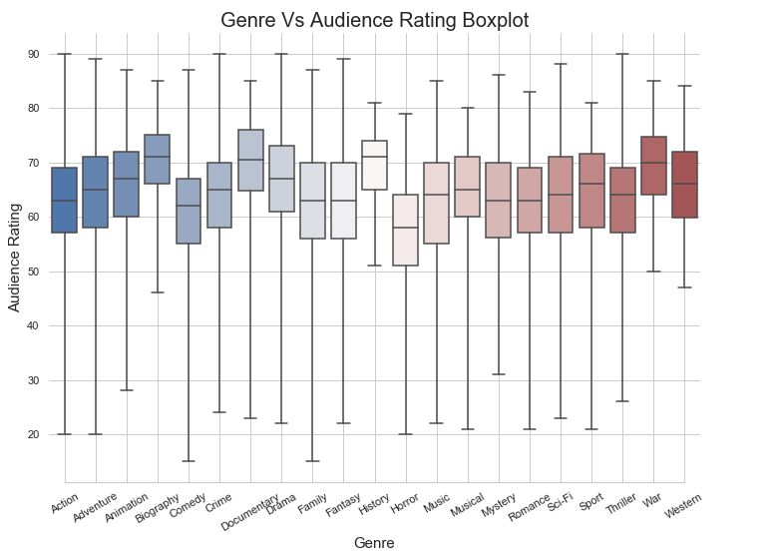
BOXPLOT:

Slide 18
Thank You

